Slide 1
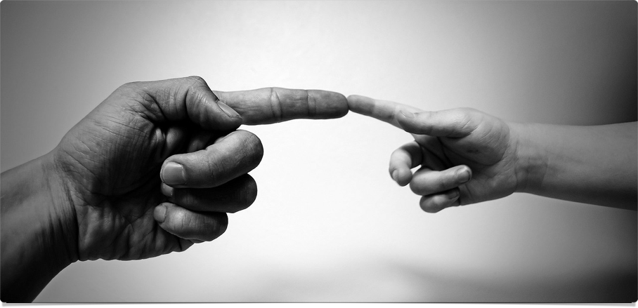
The Big Picture
The Image of God

Slide 2
“The Christian way of seeing things makes cognitive and existential sense of reality, offering us a powerful, persuasive, and attractive account of ourselves and our universe. Christianity does not simply make sense to us; it also makes sense of us. It positions us in the great narrative of cosmic history and locates us on a mental map of meaning. It offers us another way of seeing things, offers us another way of living, and invites us to share these.”
~ Alister McGrath, Surprised by Meaning, Conclusion

Slide 3
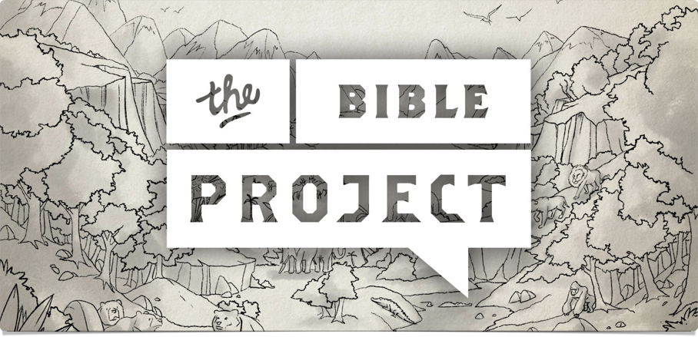
The Image of God
Watch & Discuss

Slide 4


The Image of God
 | Their Story | Our Story
Created by God | Gen 1:26-27 | Psa 139:13-16; Jam 3:9
Life & Purpose | Gen 2:15; see Num 3:7-8; 18:7 | Ecc 12:13-14; Acts 17:26-28
Fall by Sin | Gen 2:15-17; 3:1-7 | Ecc 7:29; Rom 3:10ff
Suffering & Death | Gen 3:14ff | Rom 5:12ff
“For God has done what the law, weakened by the flesh, could not do. By sending his own Son in the likeness of sinful flesh and for sin, he condemned sin in the flesh…. For those whom he foreknew he also predestined to be conformed to the image of his Son, in order that he might be the firstborn among many brothers” (Rom 8:3, 29).

Slide 5

Man & animals
Both humans (adam; 2:7) and beasts are…
  formed from the ground (adamah) (2:19)
  living creatures (1:20, 24)
  have “the breath of life” (1:30)
But only man is…
  created in God’s image (1:26)
  to extend God’s rule (1:28-30; see Lev 25:43)
Animals can… (Job 12:7-13)
  Recognize others (absent/present)
  Respond for food, play or protection
But they don’t have shared intentionality…
  Oxytocin: families, trust & empathy **PLUS**
  Mirror neurons: smiles & frowns
  And can’t tell you why & how

Slide 6
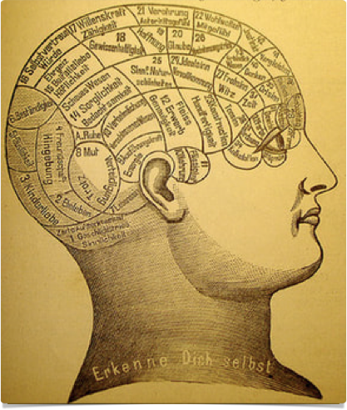
The Human Brain
100,000 miles of nerve fibers
100 million neurons
150 trillion electrical & chemical synapses
100 transmitter molecules (dopamine, serotonin, epinephrine, etc.)

Slide 7



How Humans Learn
(Aristotle, Politics 1332)
Nature (physis)
Habit (ethos)
- Instinct
- Oxytocin & mirror neurons
- Chemistry
- Innate (33-50%)
Reason (logos)
- Intuition
- Limbic system
- Community
- Imitation
- Intellect
- Neocortex
- Culture
- Imagination

Slide 8
Is there a Moral Law?
China
  Confucianism: Confucius’ Analects
  Taoism: Lao Tzu’s Tao Te Ching
South Asia
  Buddhism: the Holy Eightfold Path, the Five Virtues (Precepts) & the four Universal Virtues
  Hinduism: the Brihad Aranyaka Upanishad & The Bhagavad Gita
The West
  Athenian philosophy: Plato’s Republic & Aristotle’s Nicomachean Ethics
  Judaism: The Ten Commandments & Proverbs
  Christianity: Aquinas’ Seven Heavenly Virtues (from Summa Theologiae)
  Islam: the Koran & Alfarabi’s Fusul al-Madani (Aphorisms of the Statesman)

Slide 9


Is there a Moral Law?
WISDOM
  Creativity
  Curiosity
  Judgment
  Love of Learning
  Perspective
COURAGE
  Bravery
  Perseverance
  Honesty
  Zest
HUMANITY
  Love
  Kindness
  Social Intelligence
JUSTICE
  Teamwork
  Fairness
  Leadership
TEMPERANCE
  Forgiveness
  Humility
  Prudence
  Self-Regulation
TRANSCENDENCE
  App of Bty & Excel
  Gratitude
  Hope
  Humor
  Spirituality

Slide 10
The Moral Law
“It is the doctrine of objective value, the belief that certain attitudes are really true, and others really false, to the kind of thing the universe is and the kind of things we are. ... In the Tao [or Way] … we find the concrete reality in which to participate is to be truly human: the real common will and common reason of humanity, alive, and growing like a tree, and branching out, as the situation varies, into ever new beauties and dignities of application.”
~ C.S. Lewis, The Abolition of Man, ch. 1

Slide 11
“If minds are wholly dependent on brains, and brains on biochemistry, and biochemistry (in the long run) on the meaningless flux of the atoms, I cannot understand how the thought of those minds should have any more significance than the sound of the wind in the trees. … I am certain that in passing from the scientific points of view to the theological, I have passed from dream to waking. … I believe in Christianity as I believe that the Sun has risen, not only because I see it, but because by it I see everything else.”
~ C.S. Lewis, “Is Theology Poetry?”

Slide 12
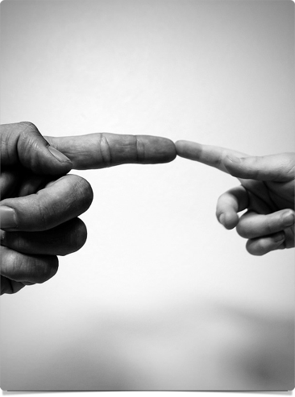
Three Big questions
How is God revealing himself?
How does this make sense of us?
Where do you stand in this story?

Slide 13
The Big Picture
The Image of God

